Slide 1
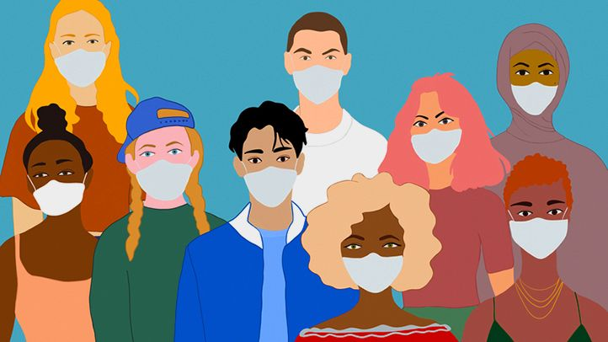
Face Mask Detection SYSC 5108 Deep Learning Final Project
Done By
Yusri Al-Sanaani | Hetvi Soni
Professor:
Changcheng Huang
Notes:
Hi everyone, welcome to our presentation about face mask detection.

Slide 2


Team Members
Yusri Al-Sanaani
Hetvi Soni

Slide 3
Presentation Outline
Introduction
Motivations
Objective
Background
Face detection
CNN
Transfer Learning
Face Mask Detection System
Methodology
Face Mask Classification
CNN Model
Transfer Learning Model
Face Mask Detection Pipeline
Results
Conclusion
References
Notes:
In this presentation, we will talk about a quick introduction about our motivations and objectives, a background about face mask detection, face mask detection system methododlogy and description. Then we will talke about our results and conclusion.

Slide 4
Introduction – Motivations
Masks play a crucial role in protecting the health of individuals against respiratory diseases:
Protect the health of individuals against virus spreading (i.e., prevent the spread of COVID-19)
Protect surgeon in operating rooms: masks act as a physical barrier against blood and bodily fluid splashes during surgery that would otherwise contaminate the surgeon's face.
Protect workers against harmful micro-objects in work environments that contain dust, micro metal/wood debris.
What is the need of face mask detection?
Face mask detection system can be implemented to automate the detection and notify the individuals, hence protecting their health.

Slide 5
Introduction – Objective
Objective
Building a Deep Learning model which can identify if the person is wearing a mask or not.
Why deep learning?
Deep learning methods are able to leverage very large datasets of faces and learn rich and compact representations of faces, allowing modern models to perform well.
Face mask detection
Refers to detect whether a person is wearing a mask or not.
In fact, the problem is reverse engineering of face detection where the face is detected using different machine learning algorithms for the purpose of security, authentication and surveillance.
Notes:
https://www.ncbi.nlm.nih.gov/pmc/articles/PMC4480558/#:~:text=Most%20obviously%2C%20they%20can%20act,face%20in%2024%25%20of%20procedures.

Slide 6
Background
Face mask detection
Refers to detect whether a person is wearing a mask or not.
In fact, the problem is reverse engineering of face detection where the face is detected using different machine learning algorithms for the purpose of security, authentication and surveillance.
Convolutional Neural Networks – CNN
Transfer Learning
Multi-task Cascaded Convolutional Networks (MTCNN)
A framework developed as a solution for both face detection and face alignment.
The process consists of three stages of convolutional networks that are able to recognize faces and landmark location such as eyes, nose, and mouth.

Slide 7
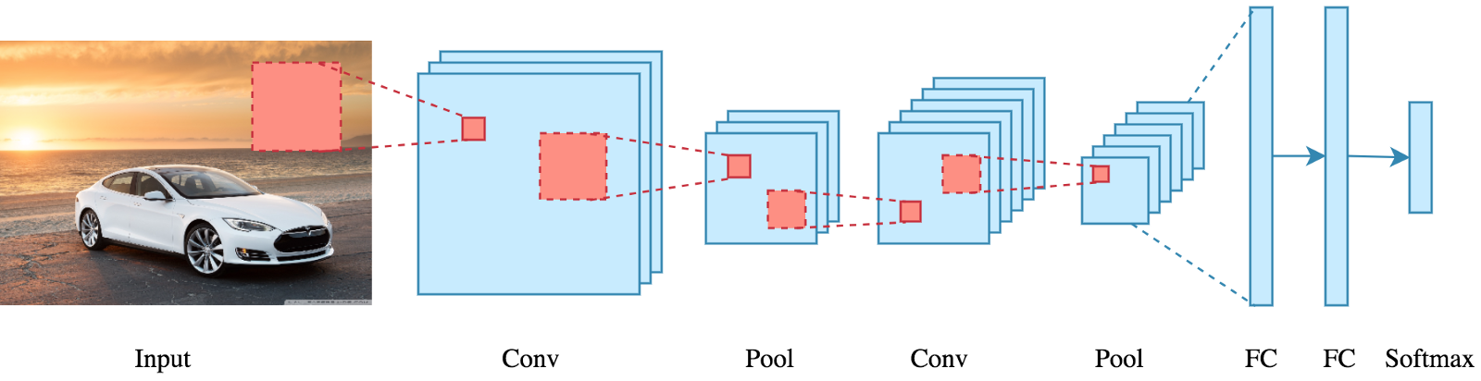
Convolutional Neural Networks – CNN
Why CNN?
CNN learns multilevel feature selection and classifier in a joint fashion.
Better performance then other traditional approaches.
Ideal for Computer Vision and image Classification task.
Why not only CNN for face mask detection?
Not scable.
Moderate accuracy.
Need object classifier along with object detector.
Not an End-to-End model.
CNN general structure[2]
[2]https://www.analyticsvidhya.com/blog/2021/05/convolutional-neural-networks-cnn/

Slide 8
Multi Task Convolutional Networks – MTCNN
Multi-task Cascaded Convolutional Networks (MTCNN)
A framework developed as a solution for both face detection and face alignment.
The process consists of three stages of convolutional networks that are able to recognize faces and landmark location such as eyes, nose, and mouth.
MTCNN has three stages :
In the first stage it uses a shallow CNN to quickly produce the candidate window.
In the second stage it refines the proposed candidate windows through a more complex CNN produced in the first stage.
Lastly, in the third stage it uses a third CNN, more complex than the others, to further refine the result and output facial landmark positions.

Slide 9
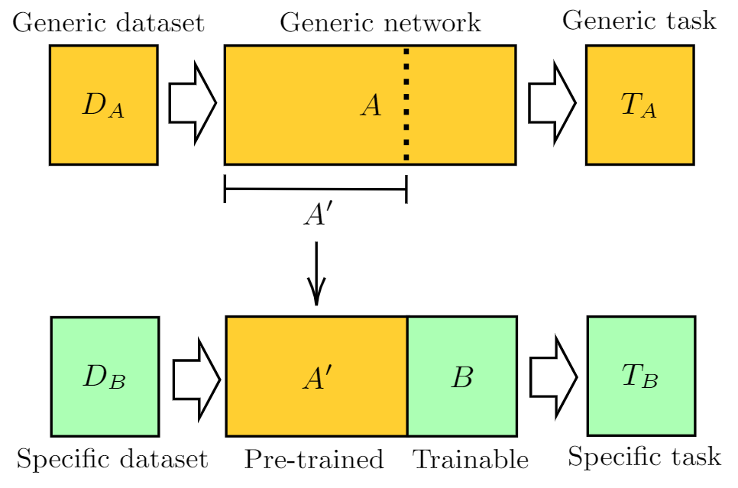
Transfer Learning
Transfer learning is process of applying a pretrained model on a new Task.
Why is Transfer learning required?
Training and Processing time reduce
Better Accuracy than Base model
Easy scalable
For transfer learning to be implemented with base model we need to freeze certain input layers and instead pass the inputs of our dataset.
For the mask detection problem we have used VGG19 model with our base model
Transfer learning model general structure[1]
[1]https://pennylane.ai/qml/demos/tutorial_quantum_transfer_learning.html

Slide 10
Face Mask Detection System – Methodology
Face Mask Classification
Face Mask Detection
Data Preparation
CNN Model
Evaluation
MTCNN
Input Image
TL Model
Classifier
Best Model
Output Image
Datasets - Kaggle:
Face Mask Detection ~12K Images
Training, Validation, Evaluation
Face Mask Detection
Testing
Evaluation Metrics
Accuracy | Precision| Recall
Loss
Confusion Matrix
ROC curve
Tools:
Tensorflow/Keras
OpenCV
sklearn
Google Colab

Slide 11
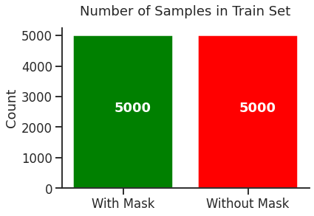
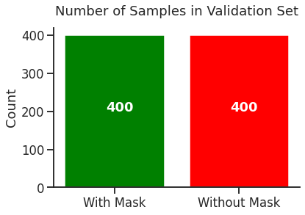
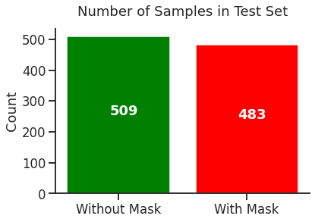
Face Mask Classification
Dataset:
Face Mask Detection ~12K Images Dataset
Training, Validating, Testing (for evaluation).
Models:
CNN Model
Transfer Learning – VGG19 Model

Slide 12
Face Mask Classification – CNN Model
CNN model:
Consists of 13 layers:
2 Convolutional Layers
2 Dense Layer,
1 Flatten Layer.
3 Max Pooling Layers
1 Dropout
3 Layers For Rescaling, Flip, and Rotation
Optimizer: adam | Loss: binary_crossentropy | Metrics: accuracy
Training and Validation with 11 Epochs

Slide 13
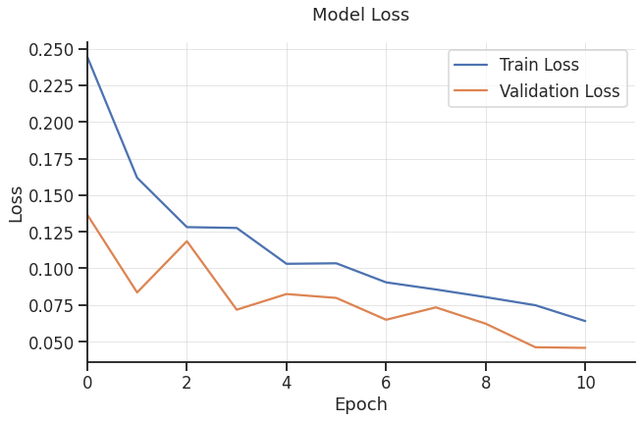
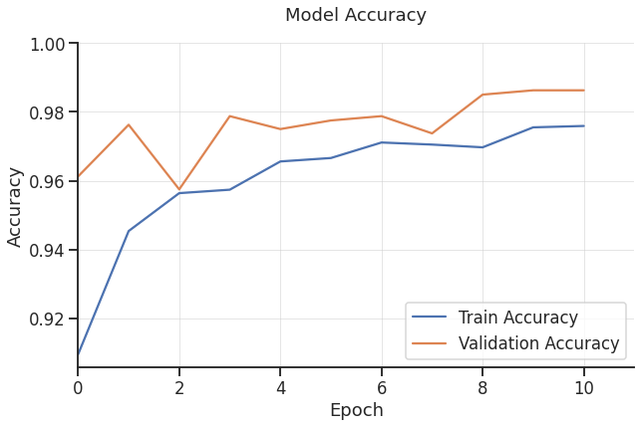
CNN Model – Evaluation : Loss & Accuracy

Slide 14
CNN Model – Evaluation : Loss & Accuracy

Slide 15
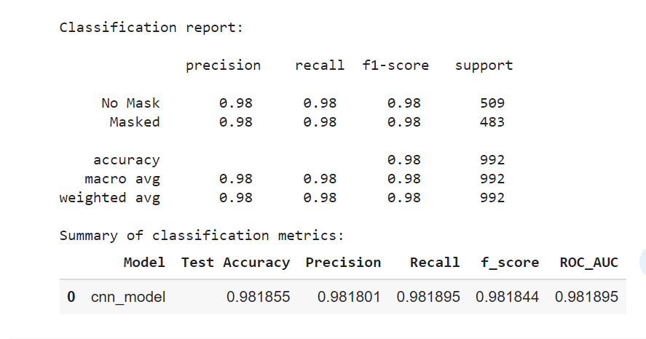
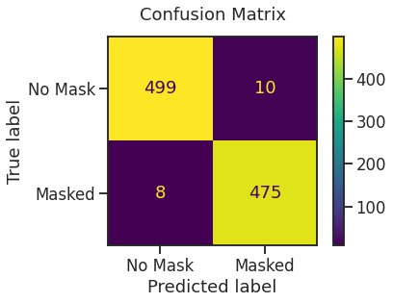
CNN Model – Evaluation : Classification Metrics
Notes:
It provides high accuracy
But it has a false positive and false negative issue
The curves are not smooth

Slide 16
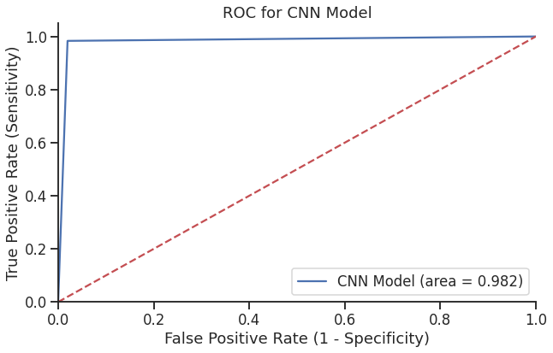
CNN Model – Evaluation: Classification Metrics

Slide 17
Face Mask Classification – Transfer Learning
Transfer Learning – VGG19 Model
A methodology of transfer learning is applied in this model on the VGG19 architecture.
Typical transfer learning process is introduced and followed here.
First, freeze all weights of the pre-trained VGG19 architecture and create a deep neural network structure containing the VGG19 as an instance and some dense layers on top of it.
Second thing is to train this deep neural network by using our datasets.
Third, unfreeze some layers of the VGG19 (in our case the last 3 dense layers) and then retrain the whole model with the same training data (fine-tuning).
This transfer learning technique can be helpful to keep VGG19 which was trained on a huge dataset of images (ImageNet) as a generic model, at the same time, make it specific to our topic/data.

Slide 18
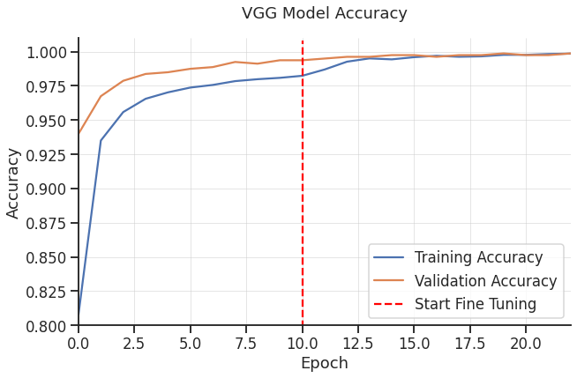
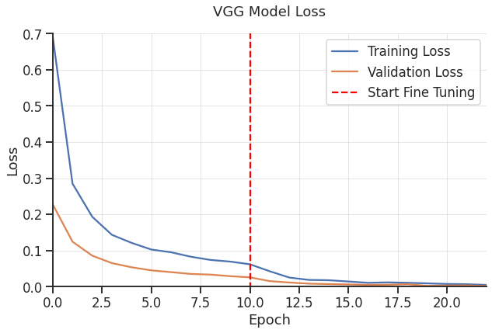
VGG Model – Evaluation: Loss & Accuracy

Slide 19
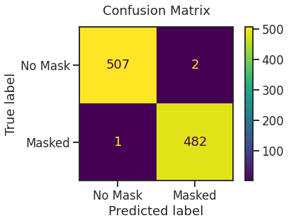
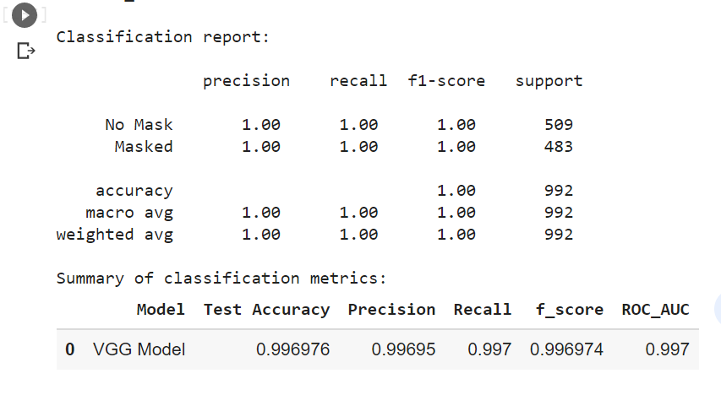
VGG Model – Evaluation: Classification Metrics
Notes:
As a result, this method offers an accuracy of 99.7% after fine-tune

Slide 20
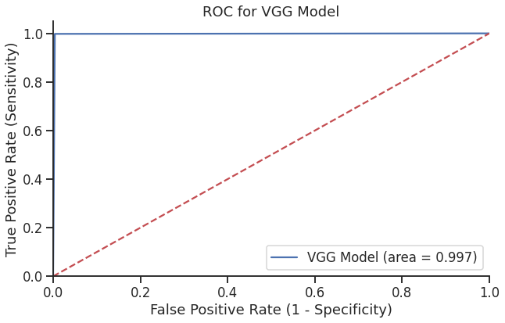
VGG Model – Evaluation: Classification Metrics

Slide 21
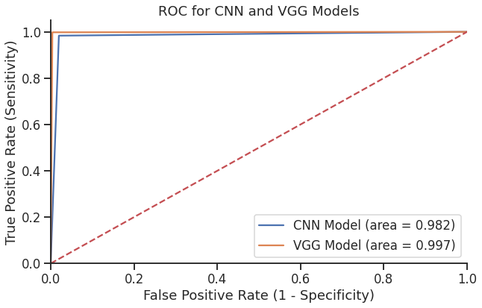
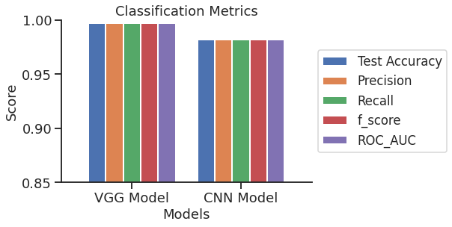
VGG vs. CNN
Notes:
The main benefits of transfer learning include the saving of resources and improved efficiency when training new models.

Slide 22
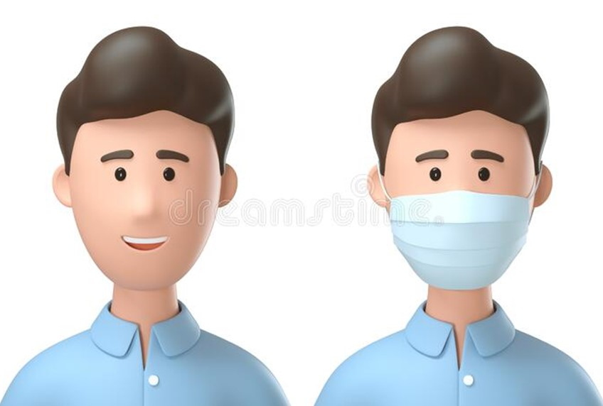
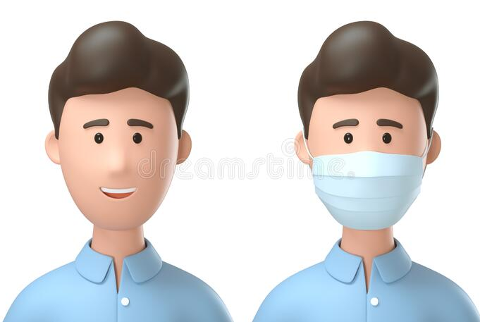
Face Mask Detection Pipeline
Input Image
Face Detector
0.99 C
0.99 C
Boxes
MTCNN
Faces
Confidence
Keypoints
Resize Image Array
Box Coordinates
Box
Mask Classifier
Without Mask
With Mask
Without Mask
CNN Model
Predict
With Mask
Notes:
www.dreamstime.com
Prediction for each face provided as [class1 class2] = [Without_Mask With_Mask]
MTCNN takes the input image as image array, detects faces each face contains bounding box coordinates, confidence score, and keypoints.
Extract the coordinates of box
Resize the image array based on coordinates img_ary[y1:y2, x1:x2]
pred = model.predict(smart_resize(img_ary[y1:y2, x1:x2], (256, 256)).reshape(1, 256, 256, 3));
print(pred)
if pred[0][0] >= pred[0][1]:
txt = 'Without Mask'
color = 'red'
else:
txt = 'With Mask'
color = 'lime'
Get predictions from the image array, it provides two scores coreesponding to without and with classes
Image Array
detector = MTCNN
faces – box coordinates for each face
Resize & reshape the image array:
resize(img_ary[y1:y2, x1:x2], (256, 256)).reshape(1, 256, 256, 3))
Pred = predict() : []
if pred[0] >= pred[1]:
Face = 'Without Mask’
else:
Face = 'With Mask'

Slide 23
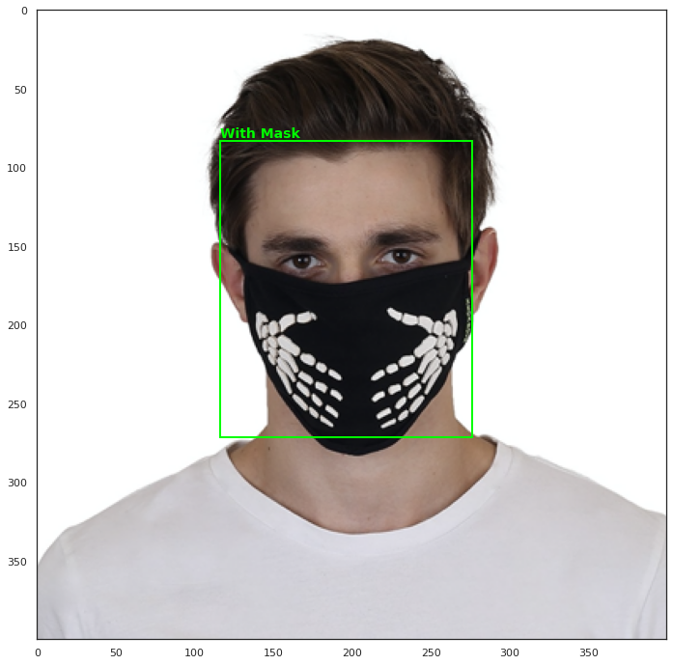
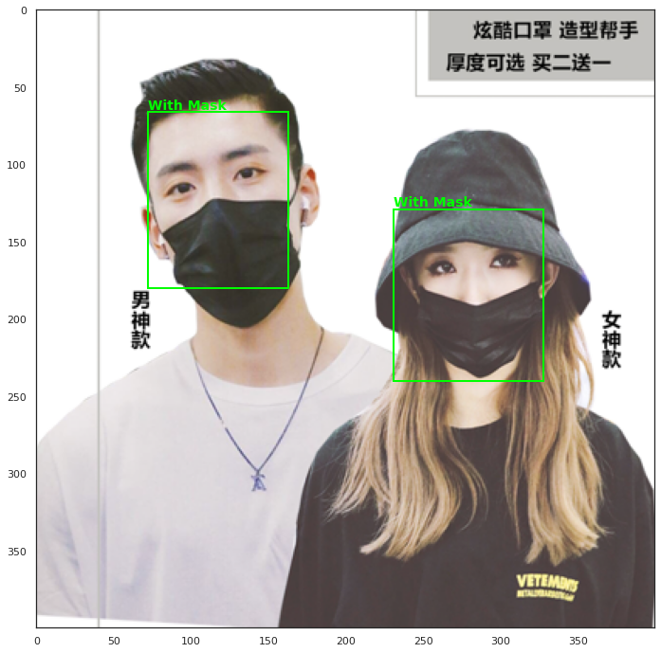
Results – Sample Test Images

Slide 24
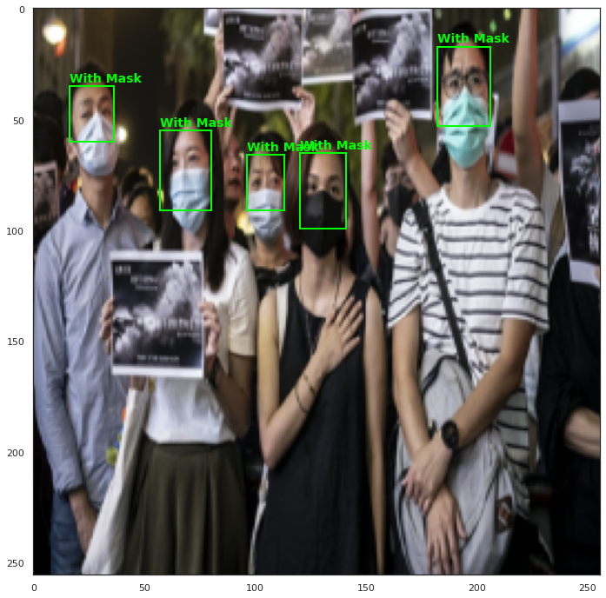
Results – Sample Test Images

Slide 25
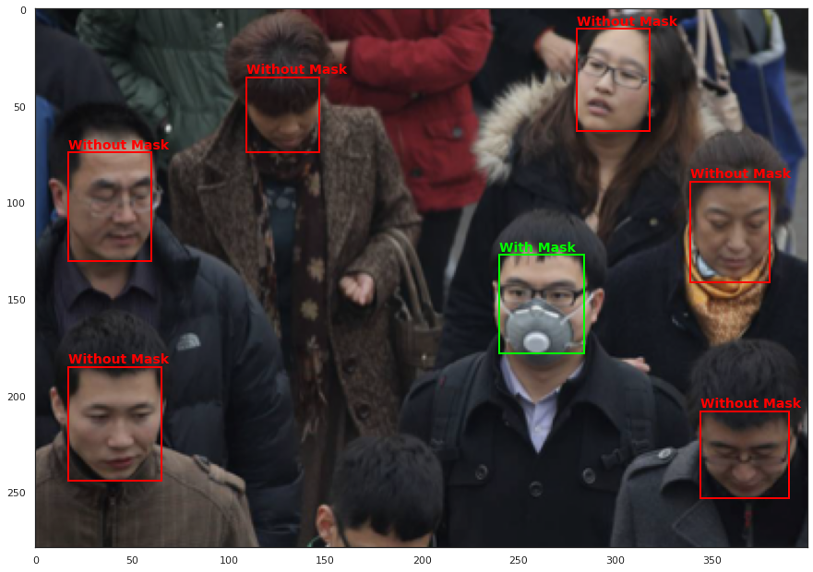
Results – Sample Test Images

Slide 26
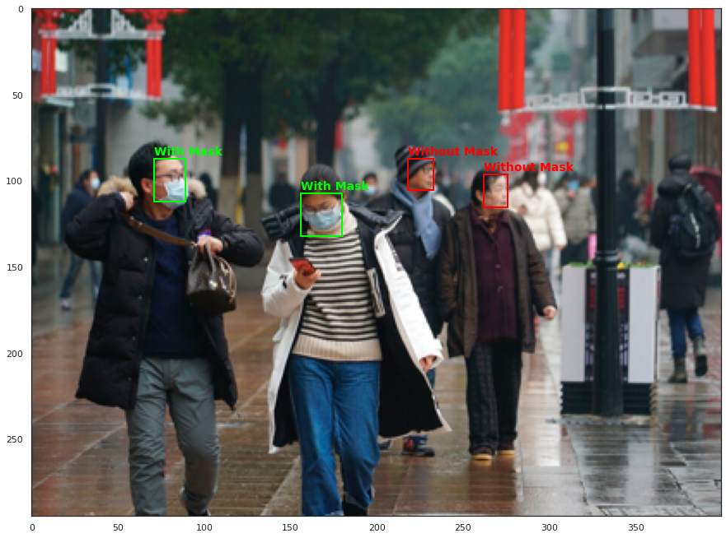
Results – Sample Test Images

Slide 27
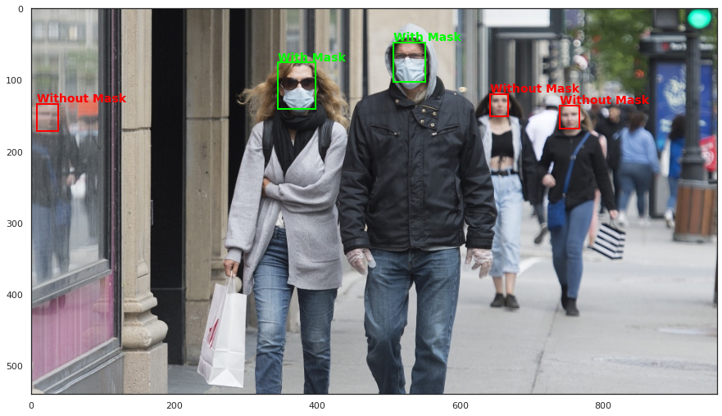
Results – Sample Test Images

Slide 28
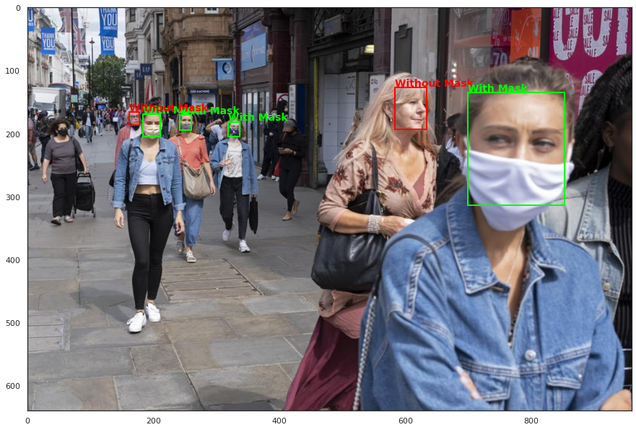
Results – Sample Test Images

Slide 29
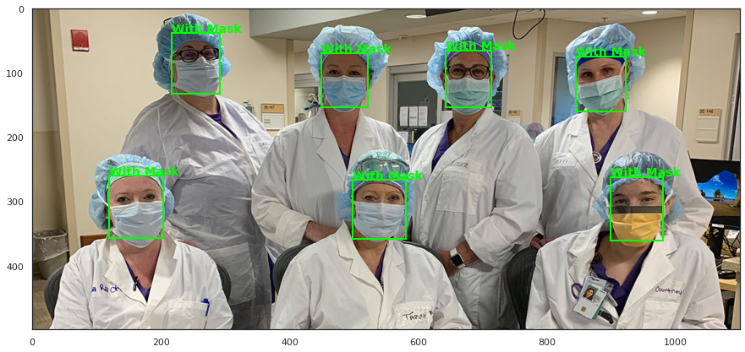
Results – Sample Test Images

Slide 30
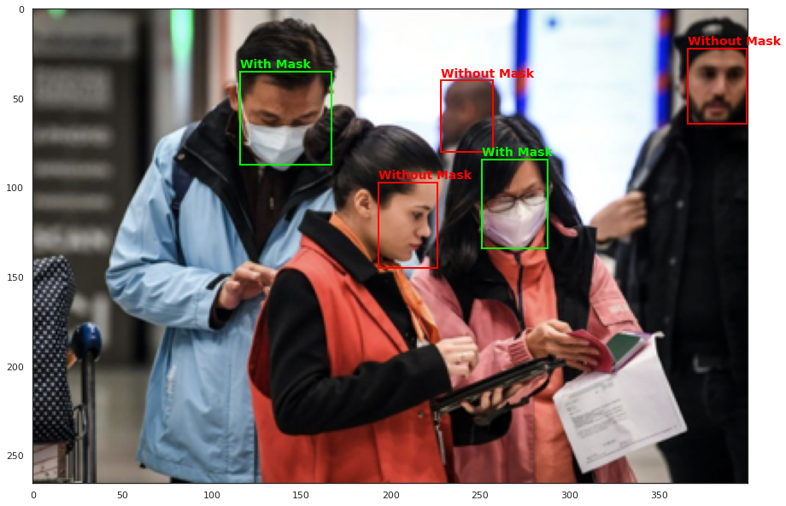
Results – Sample Test Images

Slide 31
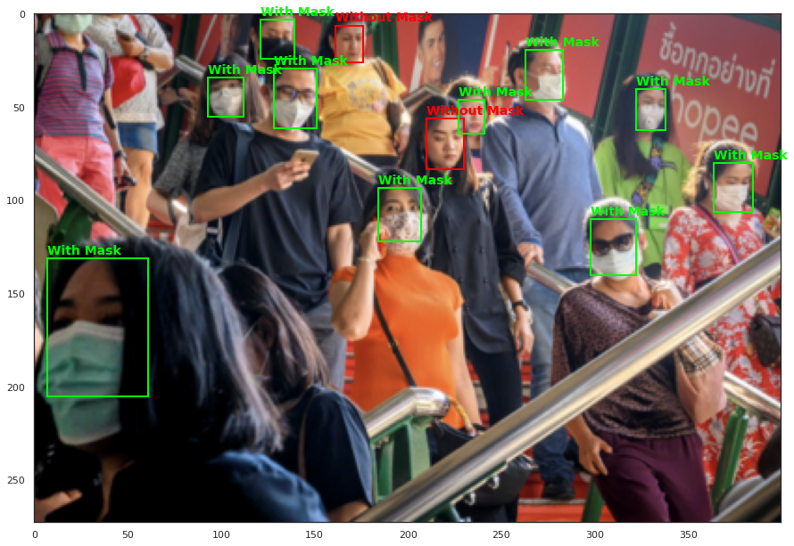
Results – Sample Test Images

Slide 32
YOLO – Face Mask Detection – Methodology
YOLO Preparation
Data Preparation
Clone YOLO
Convert BBox
YOLO Setup
Data
Prediction
Convert Annotations
Training & Validation
Data split
Evaluation
Tools:
PyTorch
OpenCV
Sklearn
Matplotlib/seaborn
Google Colab
Evaluation Metrics
Precision| Recall
Loss
Confusion Matrix
Dataset – Kaggle:
Face Mask Detection
Training, Validation, Testing

Slide 33
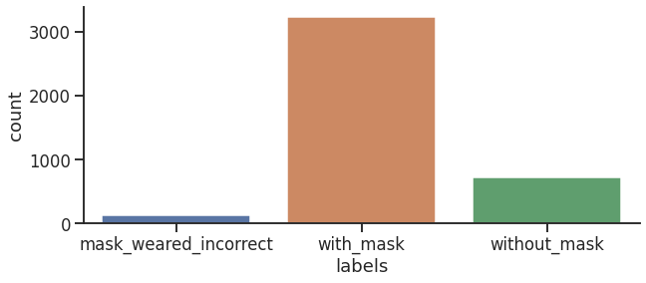
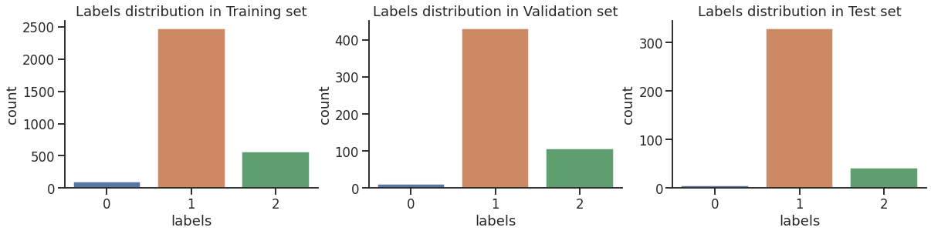
Face Mask Detection using YOLOv5
Face Mask Detection Dataset
This dataset contains 853 images belonging to the 3 classes, as well as their bounding boxes in the PASCAL VOC format.
The classes are:
With mask;
Without mask;
Mask worn incorrectly.
Total Dataset Distribution

Slide 34
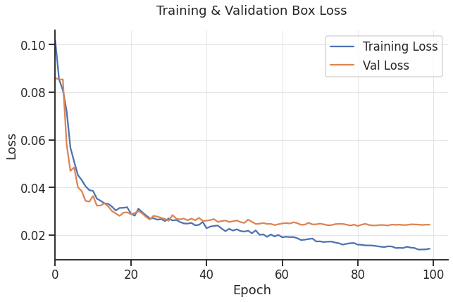
YOLO – Evaluation Metrics

Slide 35
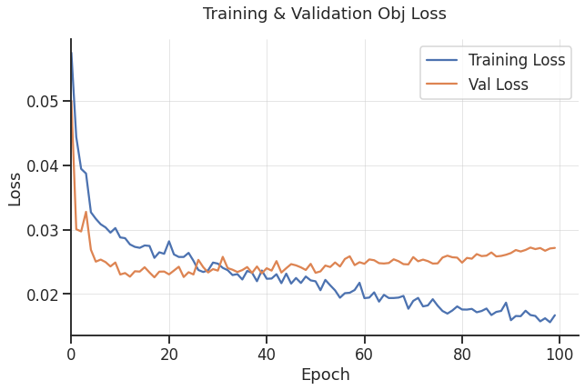
YOLO – Evaluation Metrics

Slide 36
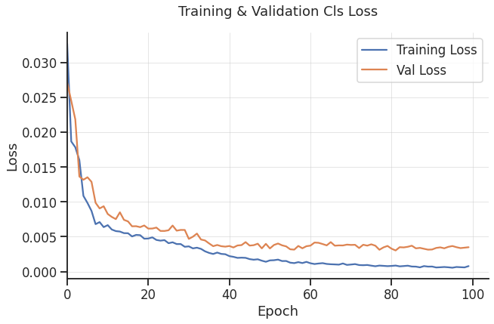
YOLO – Evaluation Metrics

Slide 37
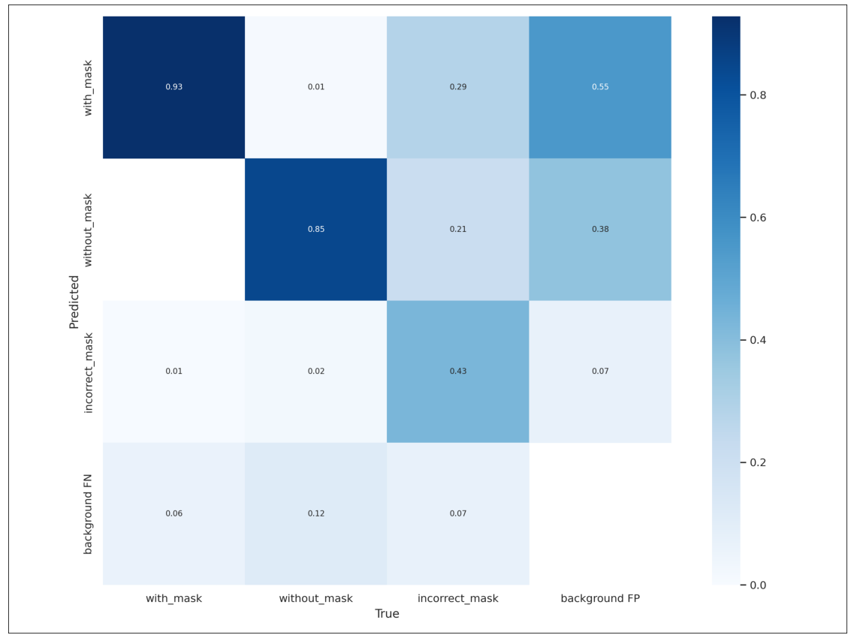
YOLO – Evaluation Metrics: Confusion Matrix

Slide 38
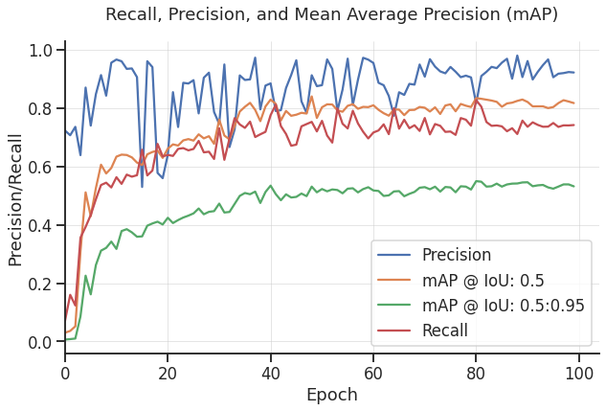
YOLO – Evaluation Metrics

Slide 39
YOLO – Face Mask Detection Pipeline
Input Images
Without Mask
With Mask
Without Mask
YOLO Model
Predict
With Mask
Mask Incorrect
Notes:
www.dreamstime.com
Prediction for each face provided as [class1 class2] = [Without_Mask With_Mask]
MTCNN takes the input image as image array, detects faces each face contains bounding box coordinates, confidence score, and keypoints.
Extract the coordinates of box
Resize the image array based on coordinates img_ary[y1:y2, x1:x2]
pred = model.predict(smart_resize(img_ary[y1:y2, x1:x2], (256, 256)).reshape(1, 256, 256, 3));
print(pred)
if pred[0][0] >= pred[0][1]:
txt = 'Without Mask'
color = 'red'
else:
txt = 'With Mask'
color = 'lime'
Get predictions from the image array, it provides two scores coreesponding to without and with classes
Image Array
detector = MTCNN
faces – box coordinates for each face
Resize & reshape the image array:
resize(img_ary[y1:y2, x1:x2], (256, 256)).reshape(1, 256, 256, 3))
Pred = predict() : []
if pred[0] >= pred[1]:
Face = 'Without Mask’
else:
Face = 'With Mask'

Slide 40
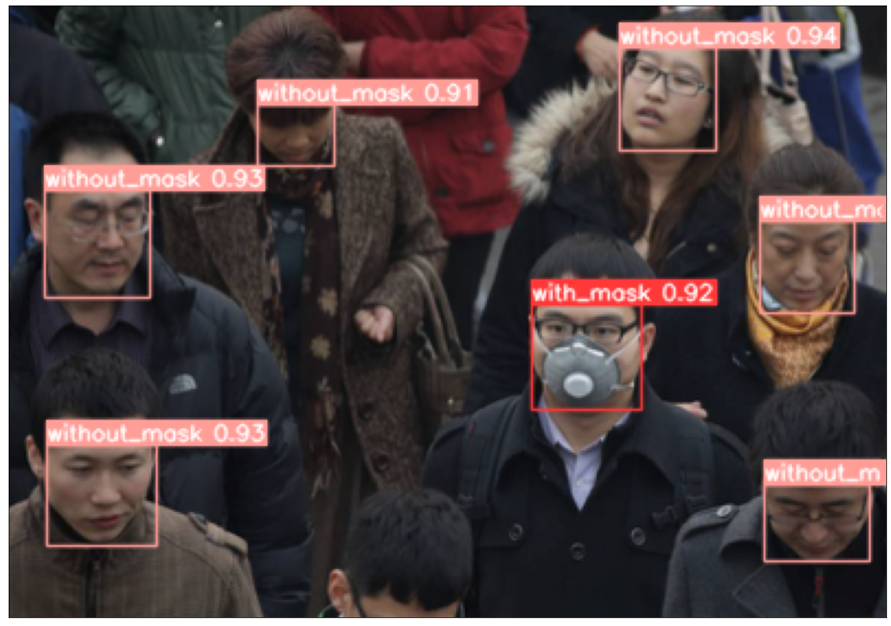
YOLO’s Results – Sample Test Images

Slide 41
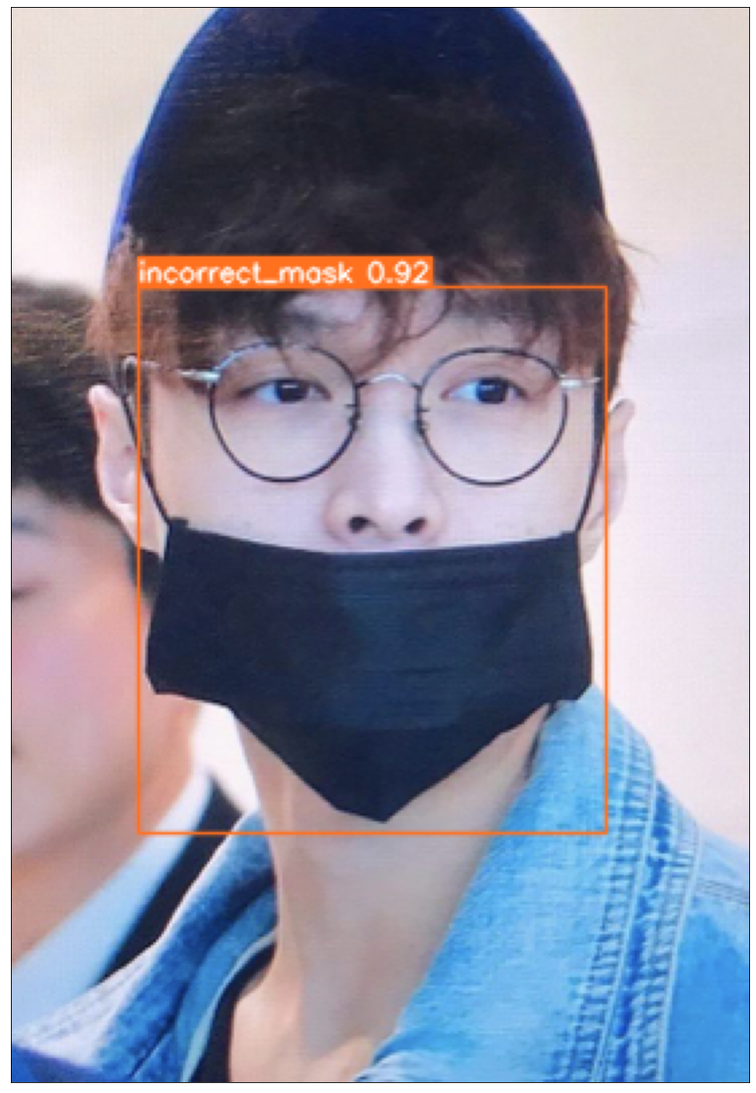
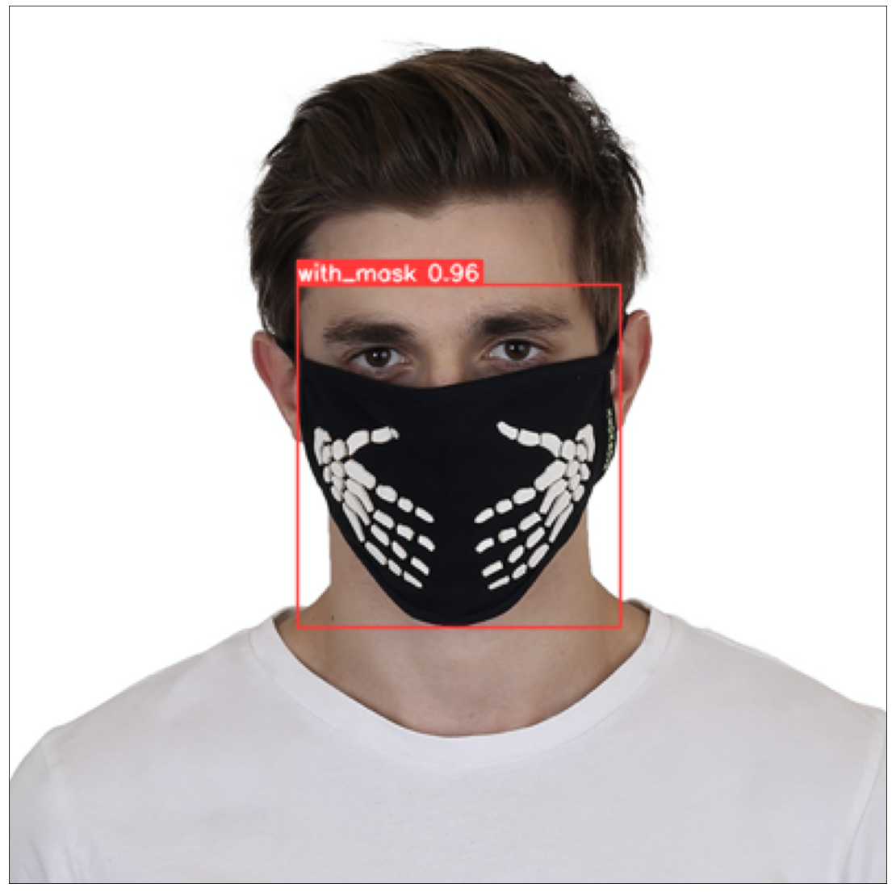
YOLO’s Results – Sample Test Images

Slide 42
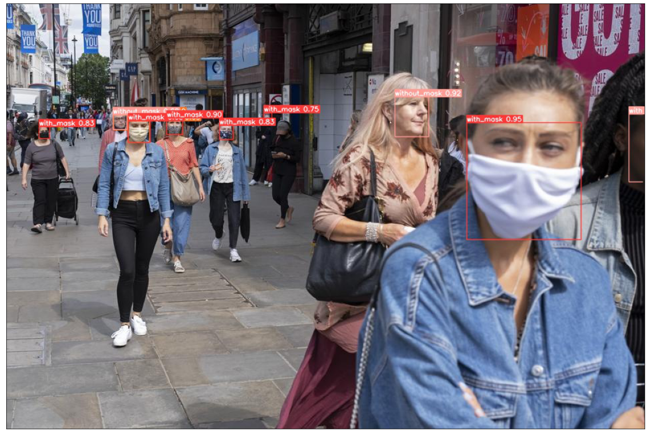
YOLO’s Results – Sample Test Images

Slide 43
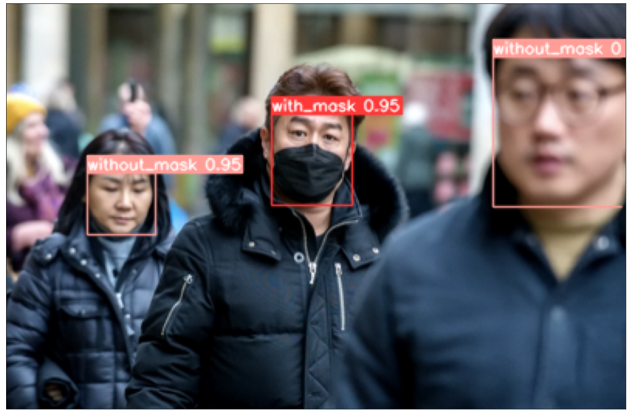
YOLO’s Results – Sample Test Images

Slide 44
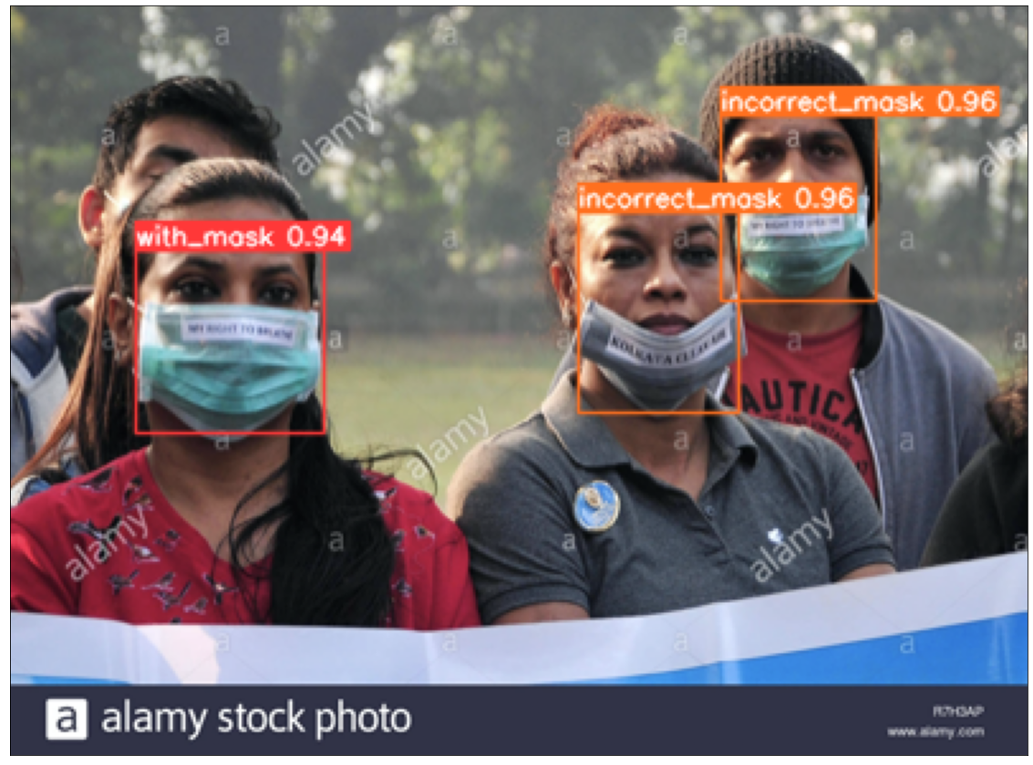
YOLO’s Results – Sample Test Images

Slide 45
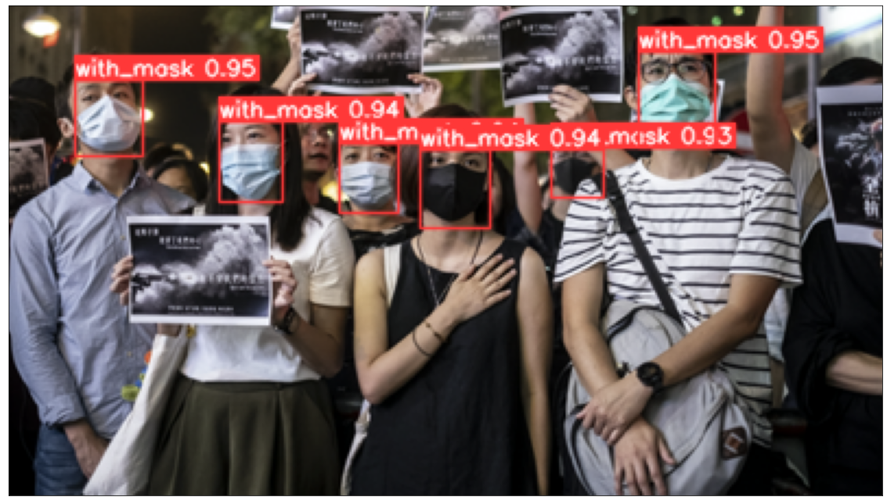
YOLO’s Results – Sample Test Images

Slide 46
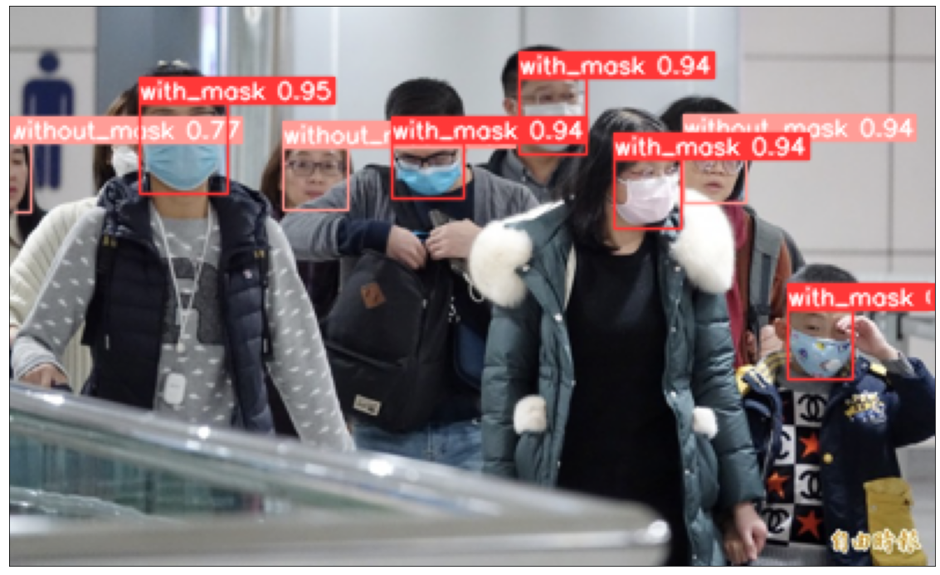
YOLO’s Results – Sample Test Images

Slide 47
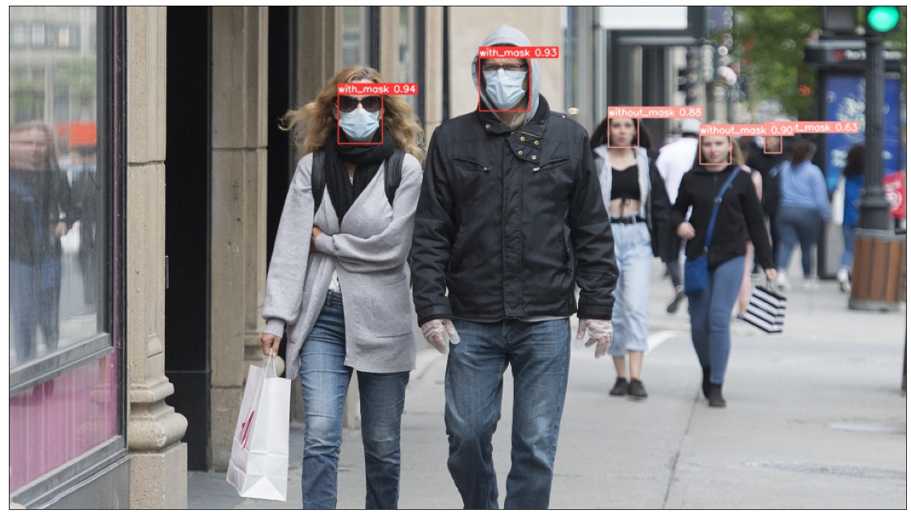
YOLO’s Results – Sample Test Images

Slide 48
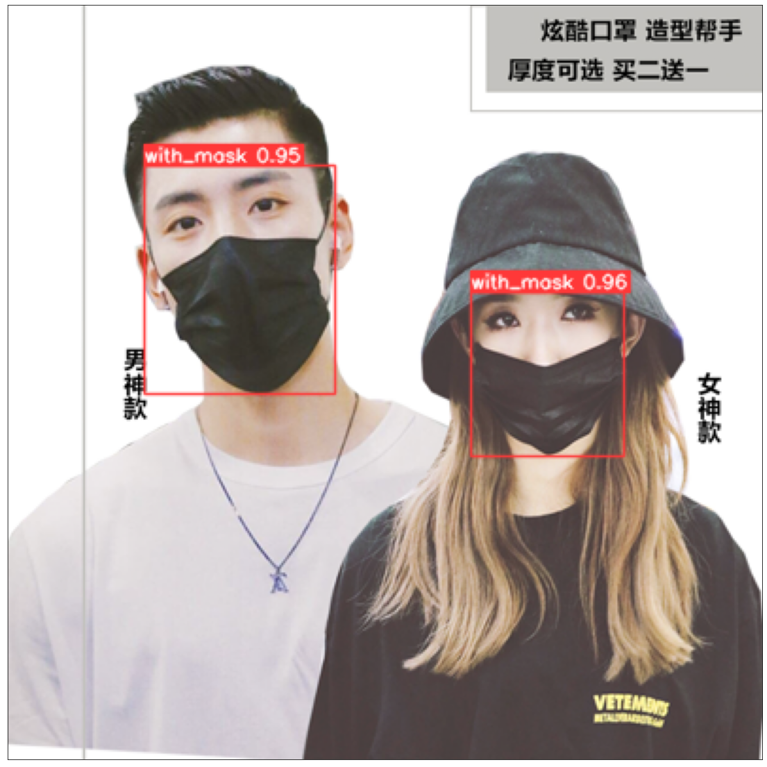
YOLO’s Results – Sample Test Images

Slide 49
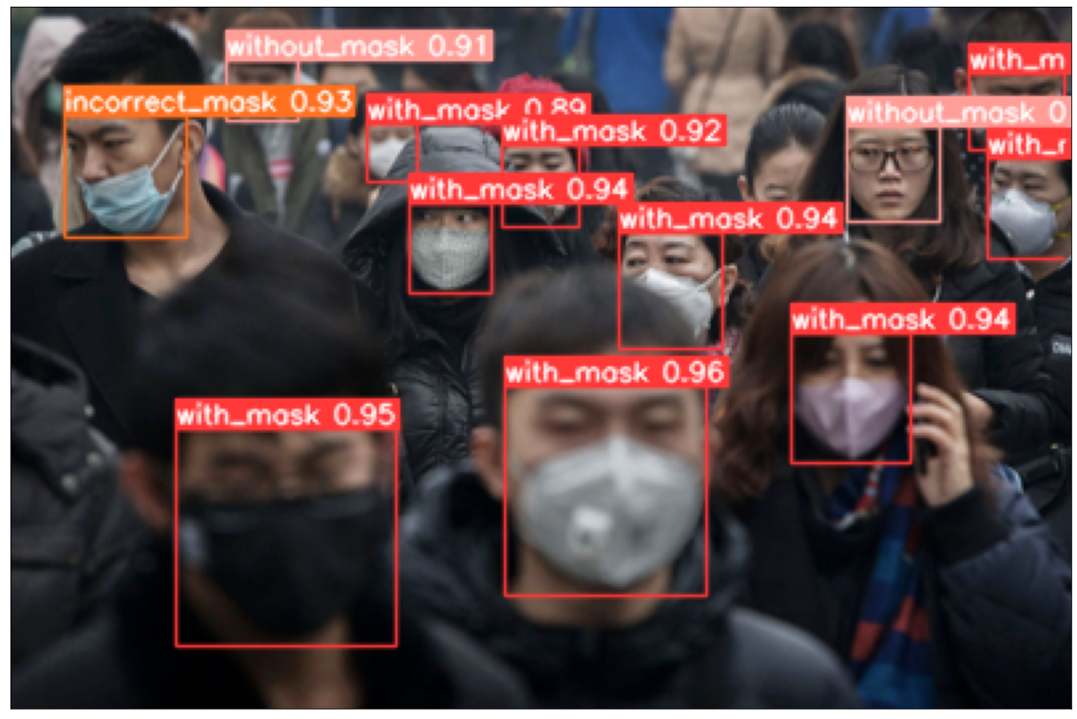
YOLO’s Results – Sample Test Images

Slide 50
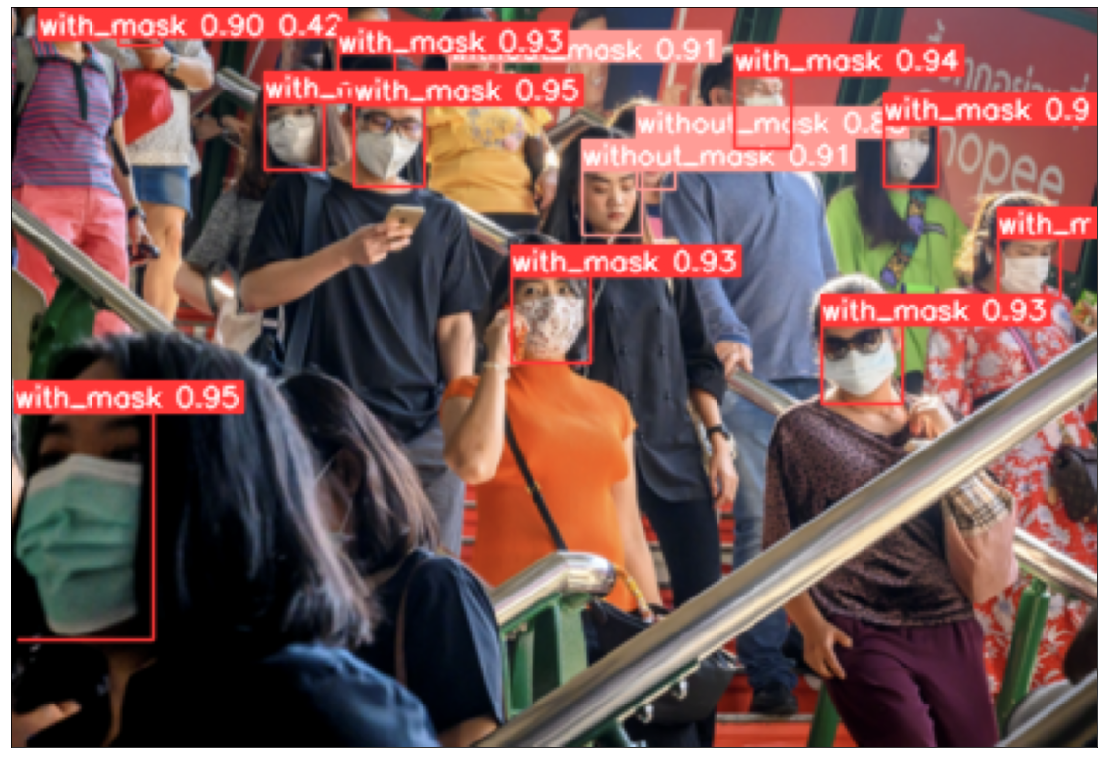
YOLO’s Results – Sample Test Images

Slide 51
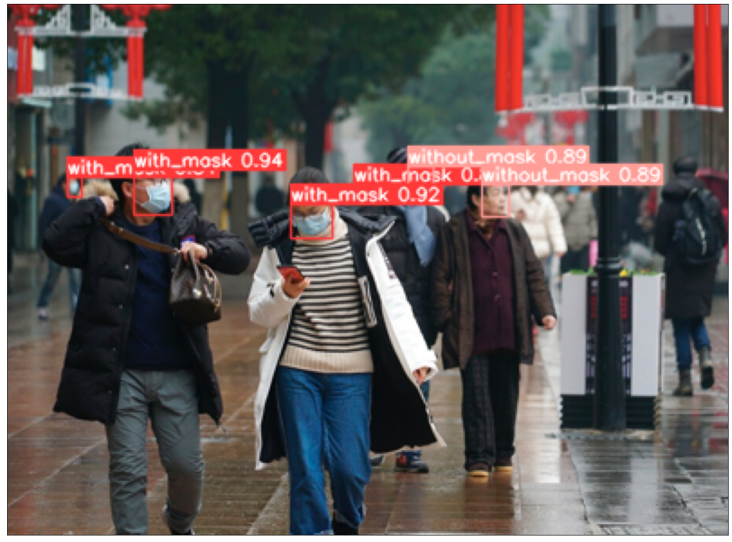
YOLO’s Results – Sample Test Images

Slide 52

YOLO’s Results – Sample Test Images

Slide 53

YOLO’s Results – Sample Test Images

Slide 54

YOLO’s Results – Sample Test Images

Slide 55
Conclusion & Future Work
CNN model has been implemented to classify the face mask dataset.
Transfer learning has been applied to tune the CNN model.
Face Mask Detector has been implemented using MTCNN and CNN classifier.
Face Mask detector has been implemented using YOLO
YOLO is a deep convolutional network used for object detection.
It is a single, end-to-end, unified network that can accurately and quickly predict the locations of different objects without using separate classifier.

Slide 56
References
C. Da Zhou, P. Sivathondan, and A. Handa, “Unmasking the surgeons: the evidence base behind the use of facemasks in surgery,” J. R. Soc. Med., vol. 108, no. 6, p. 223, Jun. 2015, doi: 10.1177/0141076815583167.
“Multi-task Cascaded Convolutional Networks (MTCNN) for Face Detection and Facial Landmark Alignment | by Rosa Gradilla | Medium.” https://medium.com/@iselagradilla94/multi-task-cascaded-convolutional-networks-mtcnn-for-face-detection-and-facial-landmark-alignment-7c21e8007923 (accessed Apr. 04, 2022).
“Face Mask Detection ~12K Images Dataset | Kaggle.” https://www.kaggle.com/datasets/ashishjangra27/face-mask-12k-images-dataset (accessed Apr. 04, 2022).
“Face Mask Detection | Kaggle.” https://www.kaggle.com/datasets/andrewmvd/face-mask-detection (accessed Apr. 04, 2022).
“COVID-19: Face Mask Detection System with TensorFlow and OpenCV | by Vishal S R | Analytics Vidhya | Medium.” https://medium.com/analytics-vidhya/covid-19-face-mask-detection-system-with-tensorflow-and-opencv-1bd19a14125e (accessed Apr. 04, 2022).
“Real-Time Face Mask Detector with Python, OpenCV, Keras - DataFlair.” https://data-flair.training/blogs/face-mask-detection-with-python/ (accessed Apr. 04, 2022).
“Detecting Face Masks Using Transfer Learning and PyTorch.” https://www.analyticsvidhya.com/blog/2021/07/detecting-face-masks-using-transfer-learning-and-pytorch/ (accessed Apr. 04, 2022).
S. Gupta, S. V. N. Sreenivasu, K. Chouhan, A. Shrivastava, B. Sahu, and R. Manohar Potdar, “Novel Face Mask Detection Technique using Machine Learning to control COVID’19 pandemic,” Mater. Today Proc., Aug. 2021, doi: 10.1016/J.MATPR.2021.07.368.
J. Cao, R. Pang, R. Ma, and Y. Qi, “Face Mask Recognition Based on MTCNN and MobileNet,” Adv. Intell. Syst. Comput., vol. 1305 AISC, pp. 433–442, 2021, doi: 10.1007/978-981-33-4575-1_41/TABLES/1.
E. Ryumina, D. Ryumin, D. Ivanko, and A. Karpov St, “A NOVEL METHOD FOR PROTECTIVE FACE MASK DETECTION USING CONVOLUTIONAL NEURAL NETWORKS AND IMAGE HISTOGRAMS,” doi: 10.5194/isprs-archives-XLIV-2-W1-2021-177-2021.
R. Arora, J. Dhingra, and A. Sharma, “Face Mask Detection Using Deep Learning,” Adv. Intell. Syst. Comput., vol. 1375 AIST, pp. 358–364, 2021, doi: 10.1007/978-3-030-73050-5_36/FIGURES/8.

Slide 57
Thank You!

